Slide 1
MEMORY MANAGEMENT
Lecturer: Suman Thapaliya
Resource: https://www.youtube.com/watch?v=qdkxXygc3rE

Slide 2



Let us take an example of 3 old Scheme Memory Management.
SINGLE USER CONTIGIOULS: 1st Scheme of MM. It was not best in terms of performance. Single Job reserves the entire memory. First job was performed and then cleared the memory for next 2nd scheme.

Slide 3


What if the job size is big ?
Size is Big: Not Executable.
It will be very slow to process.
So this Scheme is Impractical and does not work for basic scenario.

Slide 4

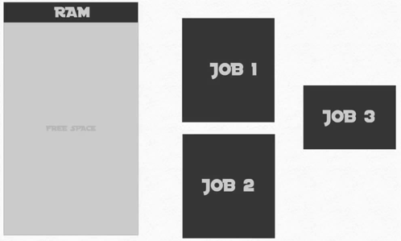
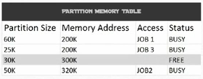
What if you want to store many process
Fixed partition
Partition methods helps until system is rebooted.

Slide 5

Objectives
Computer need to be reboot anytime.
Data should be saved after reboot.
Partition allocation should be unchanged.
What is the Dynamic solution for this … ????
SOLUTION …. !!

Slide 6


Dynamic Partition
RAM Process
I will prepare ☺ I would like 100K please …..
(Reserve the demanded
Space )
I would like 100M please ….
I would like 10K please …..
This is proven significant improvement than Fixed Partition.
Memory is not waste in partition.
Unfortunately this is not a complete solution.

Slide 7
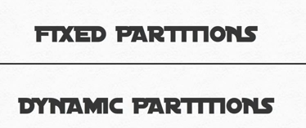
Both Fixed and Dynamic Partitions need someway to allocate the job 2 the available partitions.
Solution in 2 way
First Fit Allocation
Best Fit Allocation

Slide 8
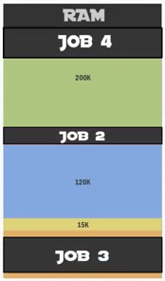
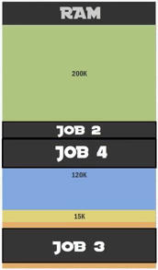
First Fit Allocation
Test where to fit the allocation.
Best Fit Allocation
Result
Slower performance but
Better Efficiency

Slide 9
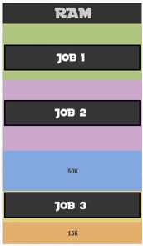
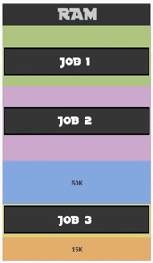
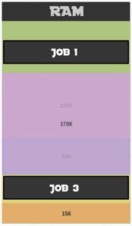
De-Allocation
When job has completed processing is then it is removed from the Memory which is also known as De-Allocation.
With Fixed Partition With Dynamic Partition
It is simply cleared It creates problem
(While joining the adjacent blocks)

Slide 10
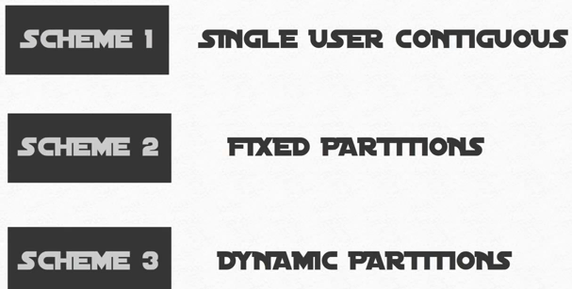
Each One require the memory manager to store a entire program in a main memory at contagious locations.
We need to find a way to avoid having to keep a whole program in a memory to run and a restriction of storing a program at contagiously.

Slide 11

What if we could divide a JOB …!!
Divide Job in Separate smaller chunks.
Yes we can, VIRTUAL MEMORY is the Solution.
Let us have a Tour of 4 Memory Allocation Scheme
1. PAGE MEMORY ALLOCATION

Slide 12




Divide One Job into equal size parts.

Slide 13
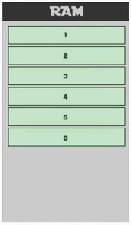
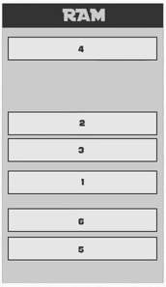
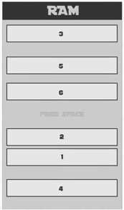
Before Program Execution
Preparations
Count how many page frame are there.
Visualize where to allocate the job.
Divide task allocated memory.
Can adjust any place where memory is available

Slide 14
Is problem solved …??
YOUR VIEW ………..

Slide 15
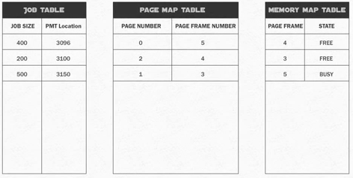
Complications
We need to keep track of all page locations.
SOLUTION ☺

Slide 16
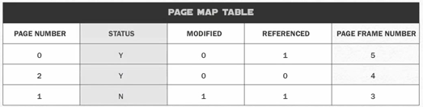
Page Memory Allocation came up with solution.
First it will send request of demand ex: 4 pages
It will allocate space for 4 pages.
To avoid more memory: added 3 more columns:
To terminate if the page is already in memory
To check if the page is modified
If the page has been referenced.

Slide 17
Replacement of Pages
By Using Page Replacement Policy
First In First Out (FIFO)
Least Recently Used (LRU)
Least Frequently Used (LFU)
Most Recently Used (MRU)
By viewing these specific algorithms we can know the replacement of pages.

Slide 18



What we have gone through …?? What if we can do this ….. ??

Slide 19

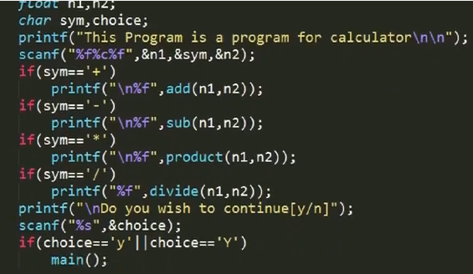
Segmented Memory Allocation
It splits the job in many segments.
They reflects the nature and structure of the code.
Code is separated
Into various functions,
Methods and structure.
4. Code can be call
One at a time.

Slide 20
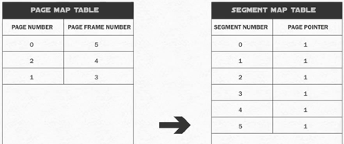

Now instead of making Page Map Table we will make Segment Map Table.

Slide 21
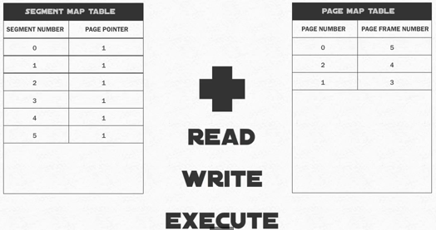
Hybrid Solution:

Slide 22
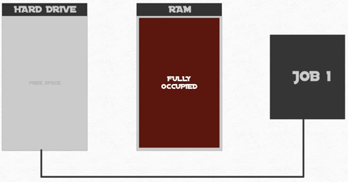
How & Why Virtual Memory is the solution
Your Task ……. To Give
me Solution ☺

Slide 23
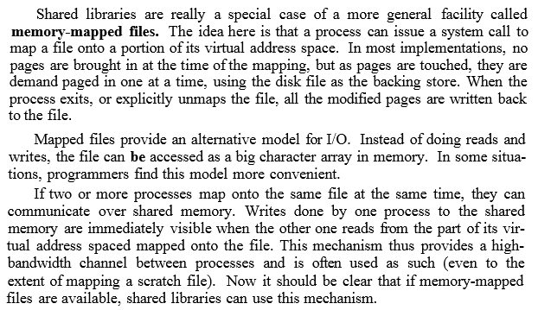
Mapped Files

Slide 24
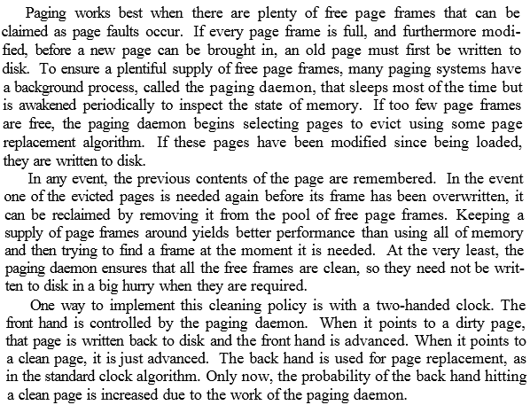
Cleaning Policy

Slide 25
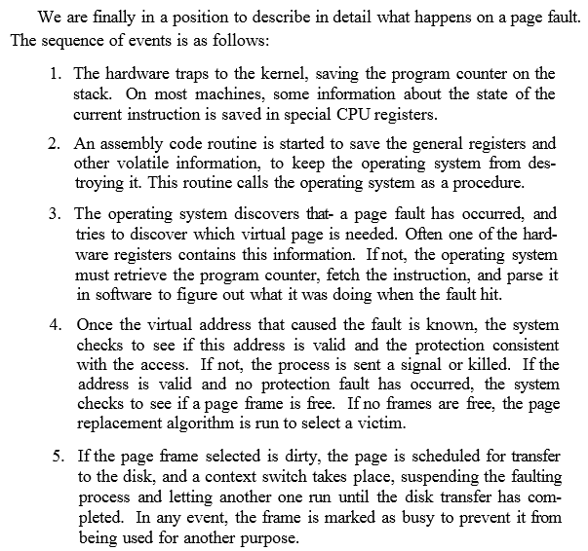
Page Fault Handling

Slide 26
